Slide 1
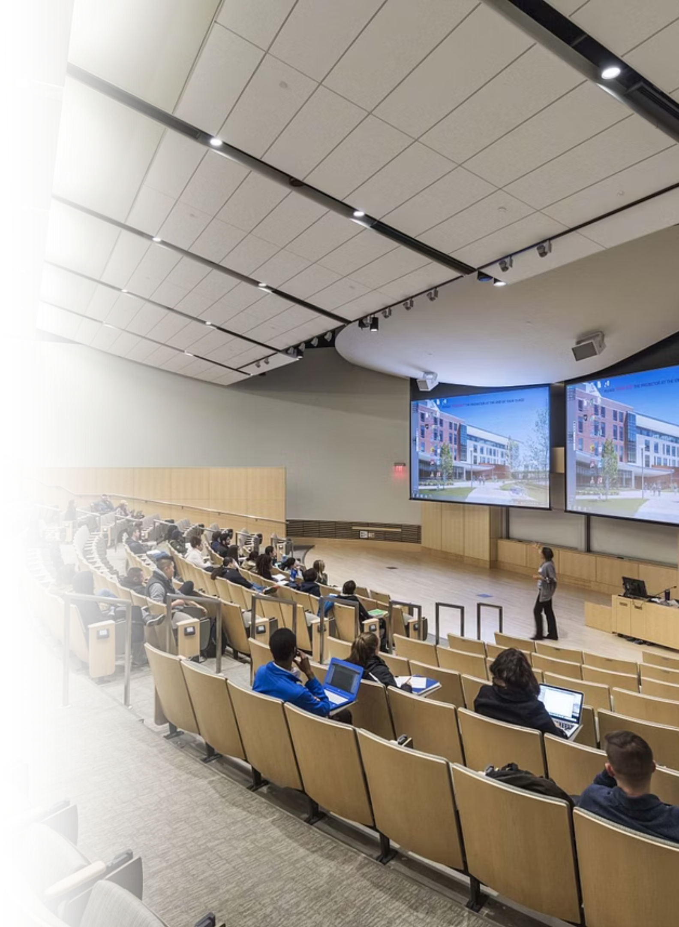
Technical Presentation and Technical Briefing
Module: Technical Communication Skills
Supervisor: Mr Mwamsangu J.
Class: BENG24COE-4 | Group 3

Slide 2


DAR ES SALAAM INSTITUTE OF TECHNOLOGY
1 | HASSAN AMIRY SHABAN | 240242453199
2 | DANIEL MICHAEL MWAMAGE | 240242439891
3 | NATHANAEL COSMAS ALFREDY | 240242455079
4 | OSLIDA LAMECK AZORI | 240242453850
5 | BARICK BONIPHACE SHIJA | 240242242949
6 | MONALISA HUSSEIN | 230242426088
7 | HELENI MUSSA KISHAGI | 240242486280
8 | JENIVA CRONEL | 240242431880
9 | ARAFA MSARIKA | 240242443992
10 | WILLIAM PAUL | 250242432573

Slide 3

Learning Objectives
Understanding Fundamentals
Audience- Centred
Approach
Effective Delivery
Mastering visual aids, presentation style, and professional delivery methods
Introduction to technical presentation principles and briefing techniques
Analysing and adapting to diverse audience needs

Slide 4

What is Technical Presentation & briefing?
Technical presentation
A structured oral presentation designed to communicate technical information effectively to a specific audience in a clear, logical, and accurate manner.

Slide 5

Technical Briefly.
Refer to a concise, informative summary or explanation of a complex subject, often found in technical documents like manuals, reports, or articles,
focusing on
facts,
processes,
specific knowledge for targeted audience to understand key concepts quickly.
Example.

Slide 6

Unlike general presentations, technical presentations focus on:
Research findings and data analysis
Engineering designs and prototypes
Software systems and architectures

Slide 7

Core Elements of Technical Presentations
Purpose
Explain, demonstrate, or share technical work clearly and accurately
2. Audience
Ranges from experts to non technical stakeholders

Slide 8

Cont. Core Elements of Technical Presentations
3. Content structure
Problem statement,methodology,results,analysis and conclusions
4. Visual support

Slide 9
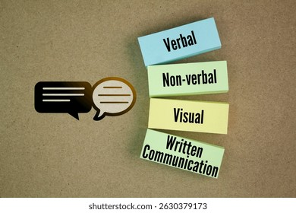
Cont. Core Elements of Technical Presentations
5. Communication style

Slide 10

Why Technical Presentations Matter
Importance of technical presentation
Clarity in Communication
Professional Credibility
Interactive Engagement
Persuasive Advocacy
Enhanced Retention

Slide 11




Audience Analysis:
Understanding Your Audience
Who
Identify audience
Knowledge
Assess expertise
Needs
Understand requirements
Adapt
Tailor delivery

Slide 12

Key Considerations on Audience analysis
Knowledge level and technical background
Professional interests and priorities
Attitudes towards the topic
Cultural background and expectations
Group size and setting

Slide 13



Structure of technical presentation
Introduction
State topic, purpose, and relevance
Establish credibility and expectations
Body
Present main points logically
Support with evidence and examples
Conclusion
Summarise key takeaways
State final message and next steps

Slide 14
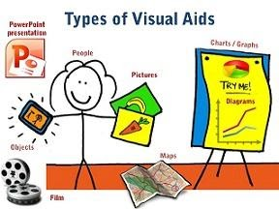
Visual Aids & Delivery Excellence
Visual Aids
Tools that support comprehension of complex technical information
:

Slide 15

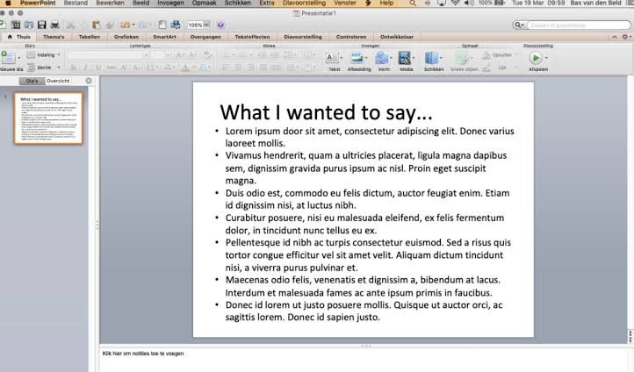
Importance of visual aids
Keep slides simple and uncluttered
Support the speaker
To avoid excessive text on slides
Example. Too much text visual aid

Slide 16

Delivery Techniques
Vocal Clarity
Speak clearly with appropriate volume and pacing
Body Language
Maintain eye contact, use natural gestures, stand confidently
Engagement
Connect with audience, avoid reading from slides

Slide 17

Practice & Professional Handling
Rehearse Thoroughly
Build confidence, manage timing, reduce mistakes
Time Management
Ensure smooth pacing and professional delivery
Handle Questions
Listen carefully, answer clearly and honestly
“NB :Admit when you don't know an answer , it demonstrates integrity and professionalism.“

Slide 18

Cross-Cultural Communication

Slide 19
Global Awareness
In today's interconnected engineering landscape, cultural competence is essential.
Use clear, accessible language
Avoid culturally specific idioms
Respect diverse communication styles
Choose universally understood examples
Cultural sensitivity prevents misunderstandings and enhances global collaboration.

Slide 20
Conclusion
Key Takeaways
Structure is Foundation
Clear narrative arc guides understanding and retention
Visuals Amplify Message
Strategic design enhances clarity and engagement
Practice Builds Confidence
Preparation transforms expertise into impactful delivery
Audience Connection Matters
Tailored content and cultural awareness drive success
Any Questions BENG24COE?

Slide 21


